Slide 1
Passcoder
TEAM MEMBER
Bowen Ma
Shun Zhang
Yichen Wang
Yuwen Cai
EC311 Project

Slide 2
PROJECT GOALS
Private Security
We provides personal encoding method for saving all the information
38%
Special Output
25%
Aside from traditional number output, we have different modes for users to choose to display
Grouping
37%
Our program allows calculations between password to group them together

Slide 3
FUNCTIONALITY OF OUR DESIGN
Encoding
Decoding
Our project machine offers an unique opportunity for users to encode their private information
When users faces difficulty reading the information, it is possible to use our machine as a decoder
Calculation
Special Output
We also offer calculation by encoding the info and analyzing it (+ - × ÷)
Despite traditional number output, we also include LED output like the Morse Code for decoding the messages

Slide 4
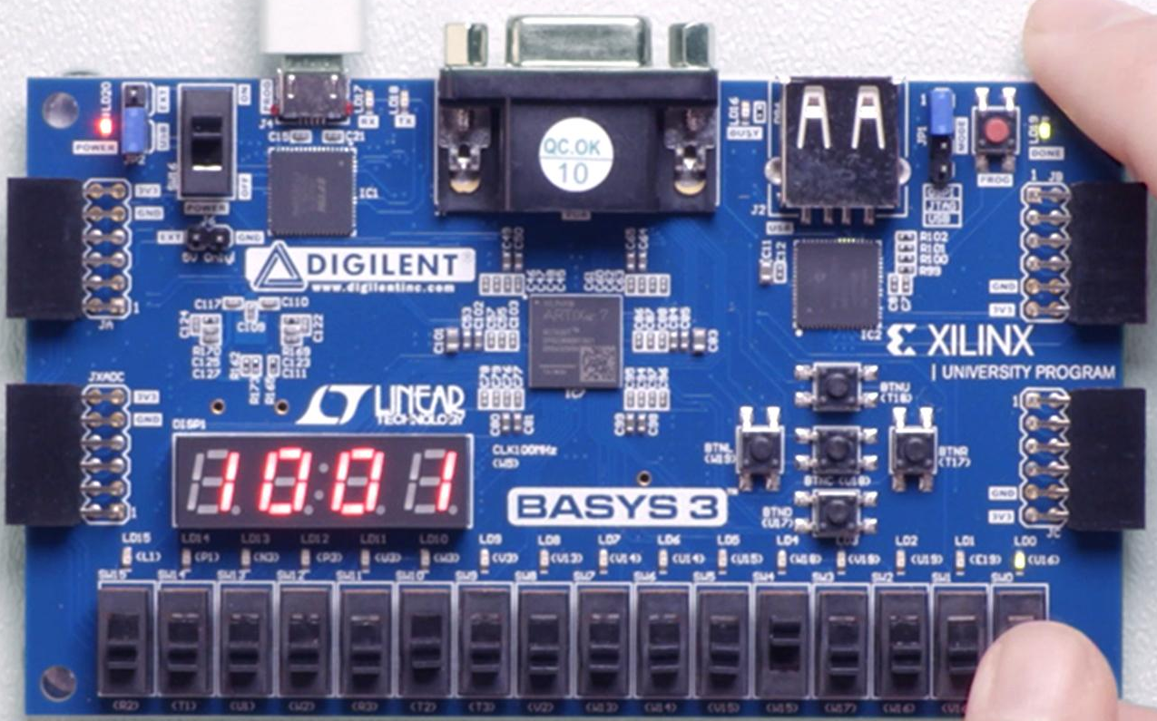
Specification
01
02
03
An FPGA board with switches
(the more switch the better)
Requirements
Information sender and receiver should know the way of encryption or decryption. (for private use, not for public)
Constraints
Only numbers are considered. Order of signal sender fixed.

Slide 5
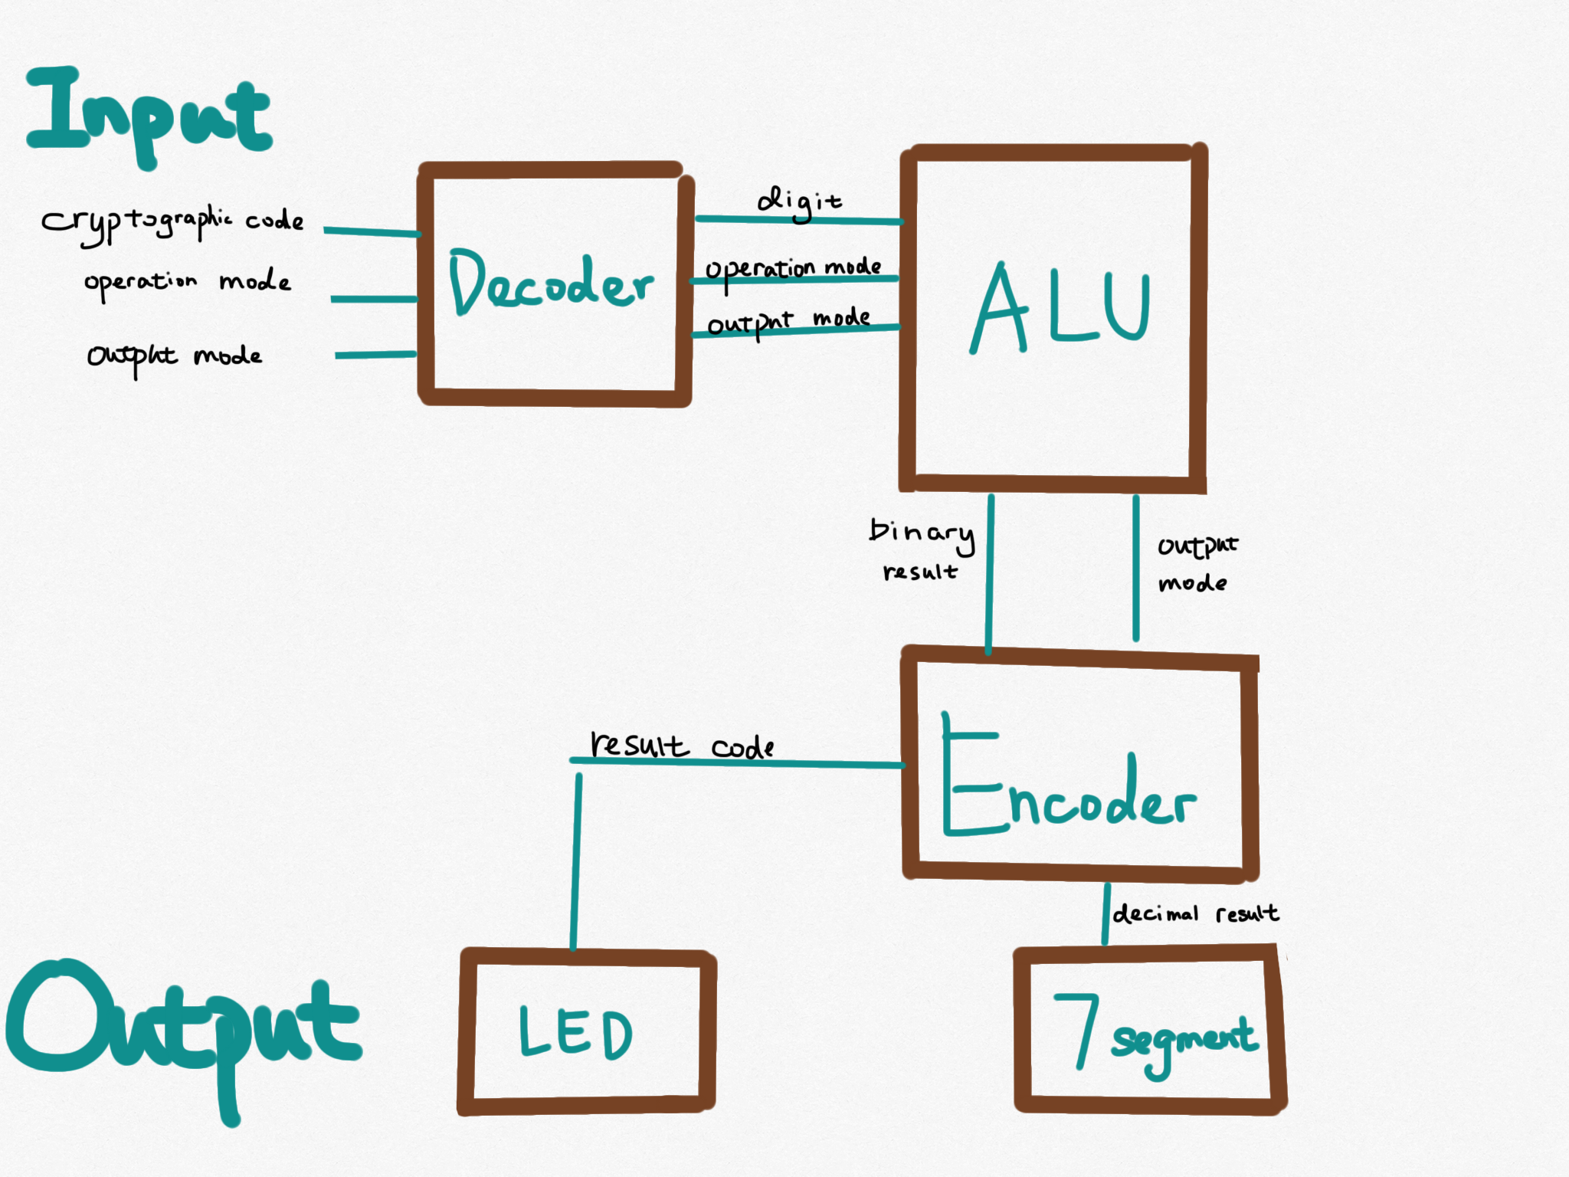
Block diagram

Slide 6
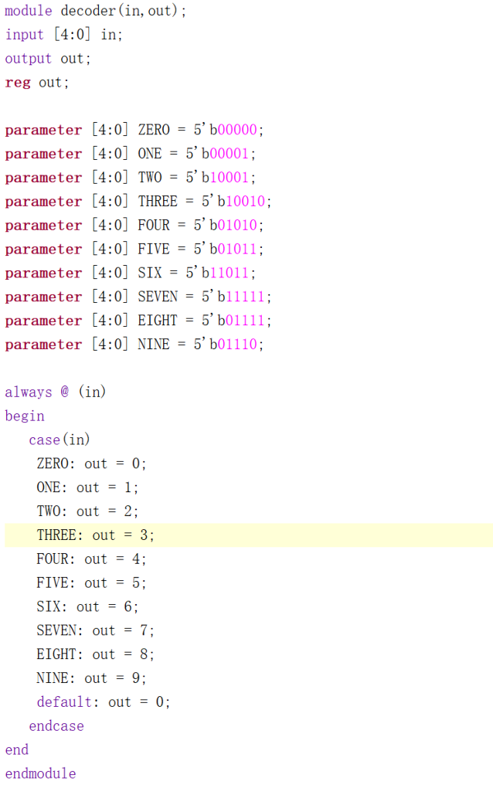
Code Snippet
0
1
2
Code Table
3
4
Decoder
5
6
7
8
9

Slide 7
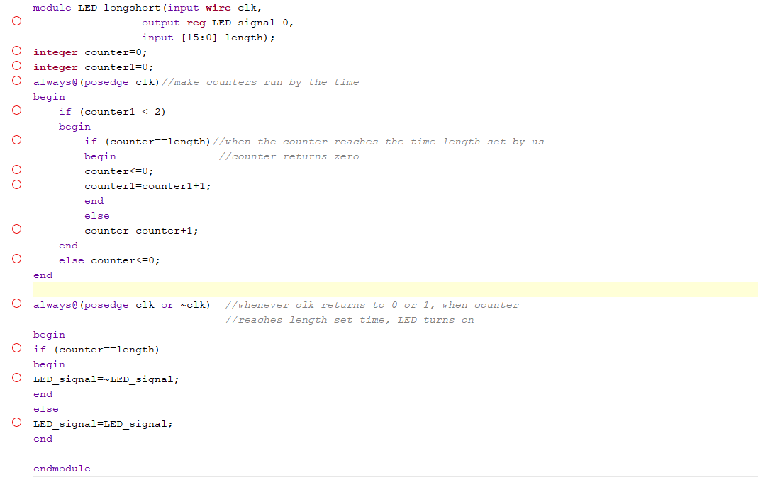
Code Snippet

Slide 8
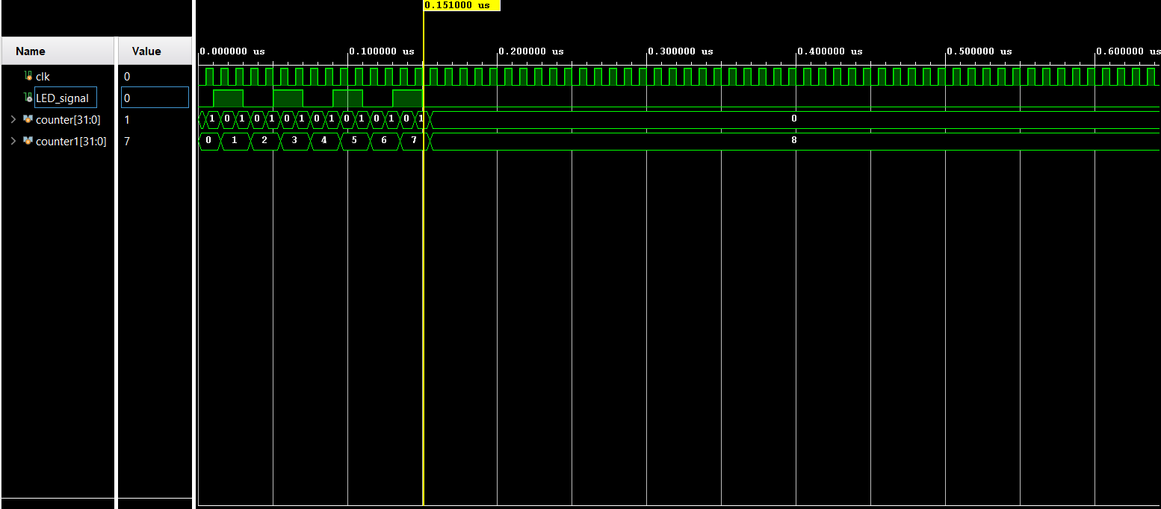
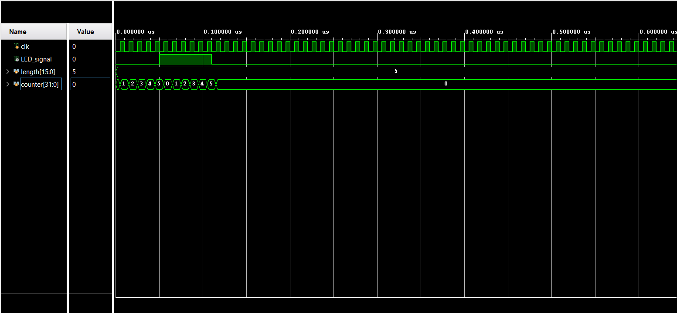
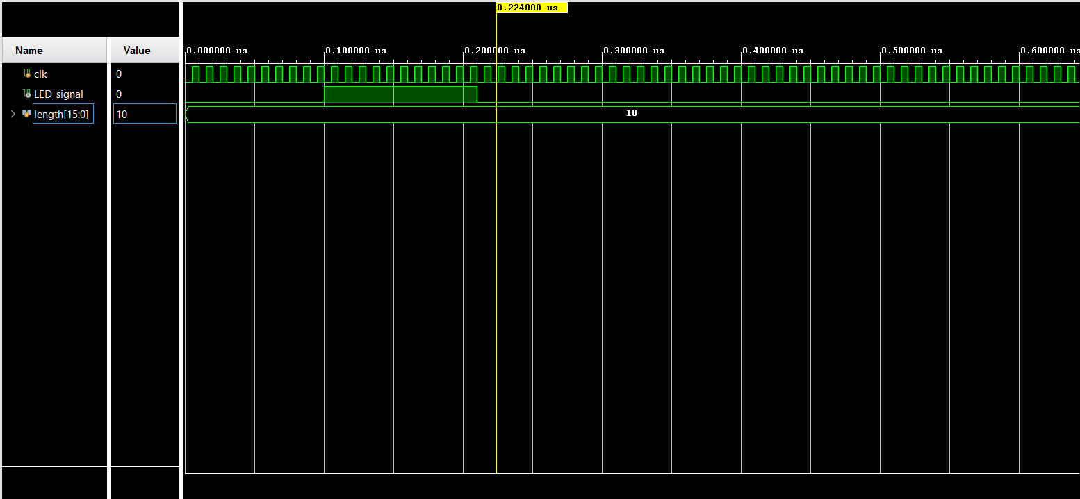

Slide 9
Success
Enhanced edition of “Morse Code”
Operational method inserted
Double security

Slide 10
Normal
Ours
“1”
“+”
“2”
“1”
“2”
Easy to be deciphered
“1” “+” “2” “*” “3” “-” “4”
……………………
The information may be more complex when we keep doing this, and it is hardly to decipher due to the insertion of calculation function.

Slide 11
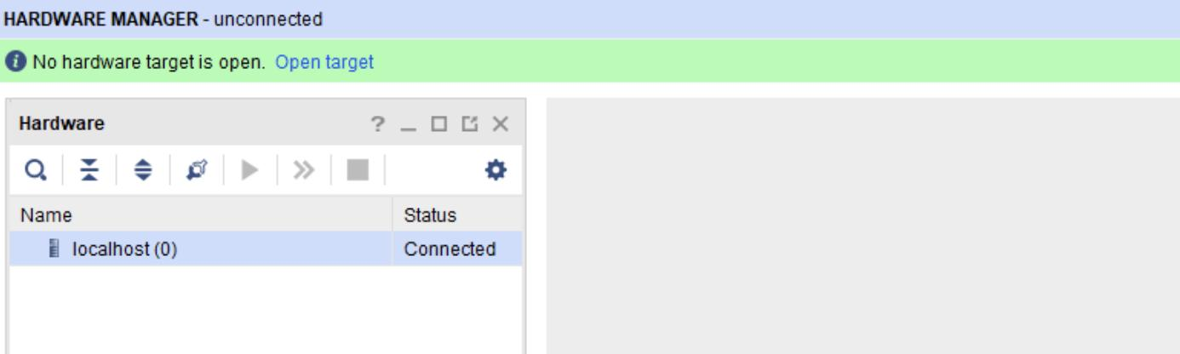
Failure
Biggest One

Slide 12
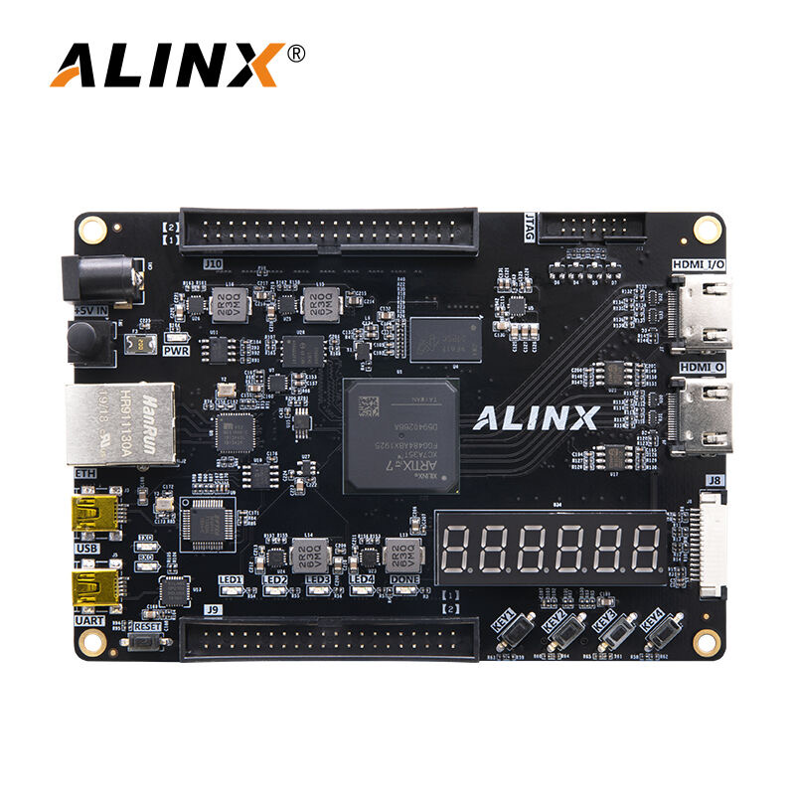
What we tried so far
Two Boards:
both are Artix-7 FGG484ABX1933
Countless Trials with different modules
Several Q&A with TA
Online Resources:
Forums.xilinx.com
Silabs.com
Github.com
Blog.csdn.net
Eevblog.com
etc.

Slide 13
What we tried so far
Vivado Issue?
Different modules, constraint files, and frequency.
Cable Issue?
Three pieces of USB to UART cables w/ USB 2.0 and USB 3.0
Cable Drivers Issue?
Deleted and reinstalled windrvr6.sys
Deleted and reinstalled digilent
Tried USB to UART Bridge from other company--- Silicon Labs
Xilinx Virtual Cable
NONE OF THEM WORKED

Slide 14
THANKS
AND! We will keep Trying
Do you have any questions?
bma1024@bu.edu
caicai@bu.edu
shunz@bu.edu
wyichen@bu.edu
Please keep this slide for attribution.

